Slide 2

STOCK PRICE PREDICTION
Mini project of course IT2022E
Applied Statistics and Experimental Design
Chu Anh Duc
Tran Quang Hung
Vu Thuong Tin
Do Dang Vu
Phan Dinh Trung
20230081
20235502
20230091
20235578
20230093
Lecturer
Dam Quang Tuan

Slide 3
Introduction

Slide 4
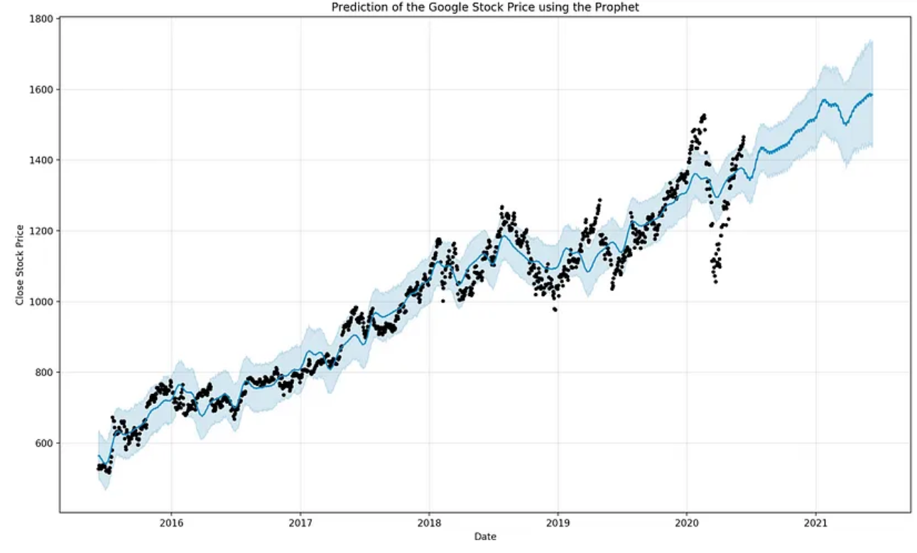
INTRODUCTION
1. Topic
We want to forecast trends and accurate results in stock prices to help investors make decisions and maximize returns

Slide 5
INTRODUCTION
2. Contribution
We explore efficient methods for predicting both trend and price movements
in the stock market.
Weighted KNN
Random Forest Regression (RF)
STOCK PRICE PREDICTION
Long Short-Term Memory (LSTMs)
XGBoost (XGB)
Gated-Recurrent Unit (GRUs)

Slide 6
Data

Slide 7
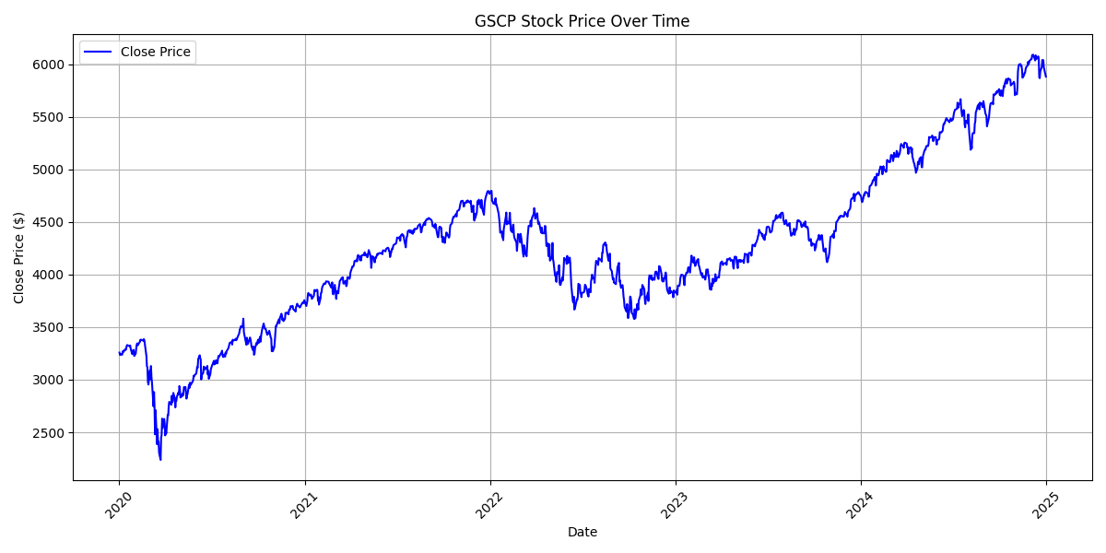
Data
Historical data of two stocks, S&P500(^GSPC) and IBM Stock(IBM) from 2000-01-01 to 2023-06-01.
The data sample is obtained from Yahoo Finance and and we mainly use open, high, low, close figure to predict.
It consists of the daily closing prices with a total number of samples including 5890 trading days for each stock.

Slide 8
Solution

Slide 9
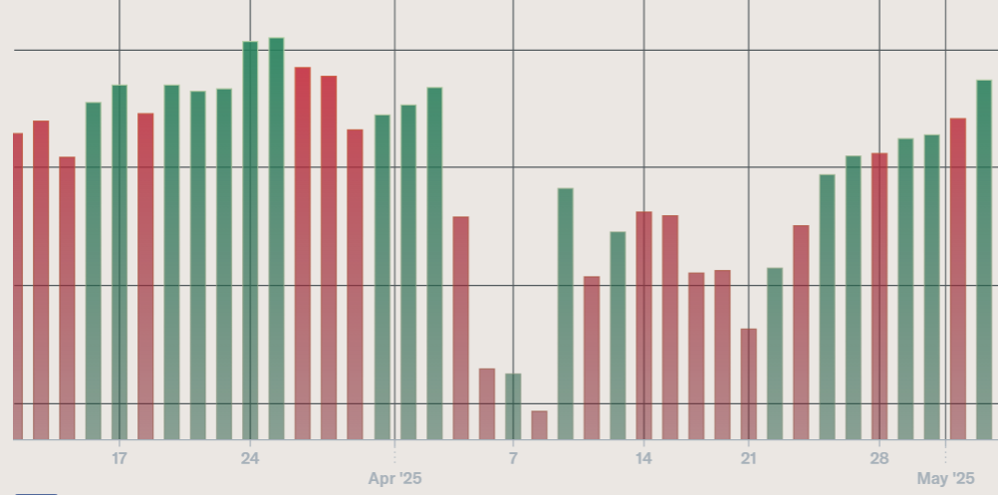
Solution
Approaches: Using both classification and regression techniques.
Classification: Predict the trend for a particular time window (Up trend or Down trend) using K-Nearest Neighbors

Slide 10
Solution
Regression: Use deep learning methods: GRU and LSTM, machine learning methods: XGBoost, Random Forest Regression
Feature Engineering for GRU and LSTM: Use lag features – Close price in the last 20 days
Next close price?
Lag features

Slide 11
Solution
Feature Engineering for XGBoost and Random Forest: Use lag features – Close price in the last 14 days to predict for the percentage change for the next day close price
Next percentage
change?
Lag features
Next close price

Slide 12
Experiment

Slide 13
Weighted KNN

Slide 14
Weighted KNN
Data Preprocessing
Process of algorithm
Results

Slide 15
Why using Weighted KNN instead of Standard?
Standard KNN lacks a mechanism to weigh the importance of neighbors, leading to suboptimal predictions
It treats all features equally, ignoring temporal dependencies and trends.

Slide 16
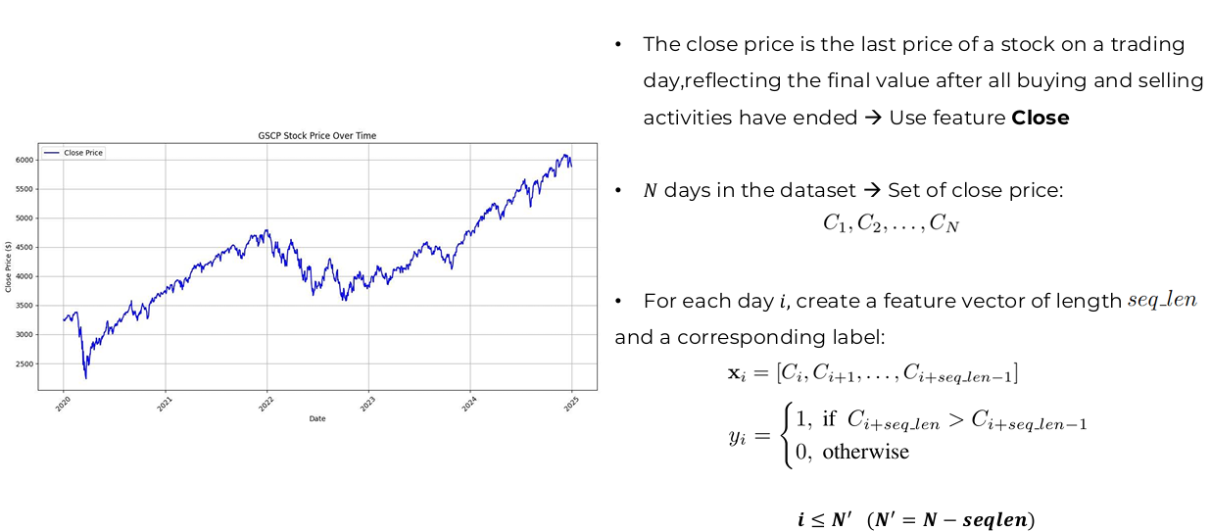
1. Data Preprocessing
Why using Weighted KNN instead of Standard?
Standard KNN lacks a mechanism to weigh the importance of neighbors, leading to suboptimal predictions
It treats all features equally, ignoring temporal dependencies and trends.

Slide 17
1. Data Preprocessing
Parameter seq_len – size of each feature vector:
Define the length of the historical window used to analyze past trends, playing a critical role in enabling the model to learn meaningful patterns from time series data.
Allow the algorithm to capture relevant context from previous observations, which is essential for making accurate predictions about future events.

Slide 18
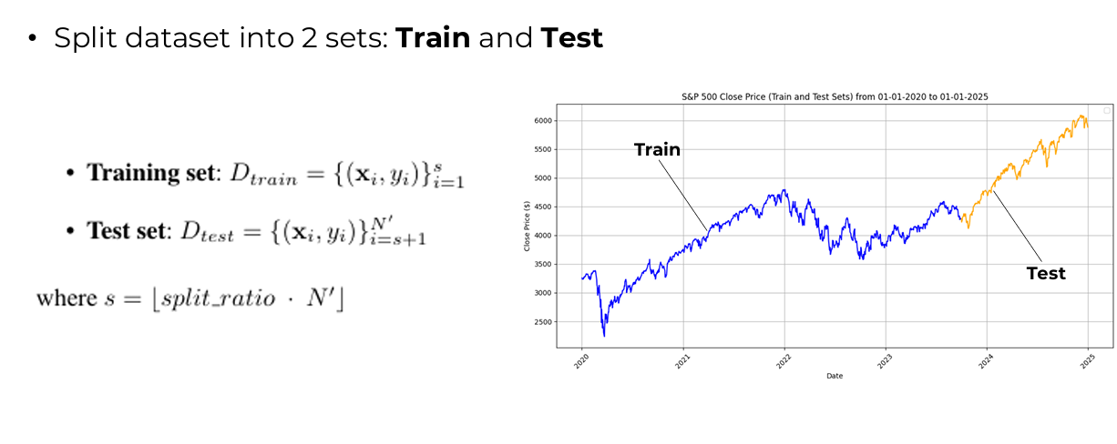
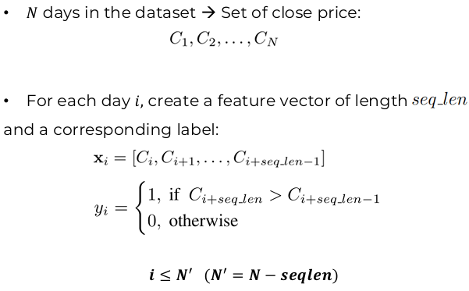
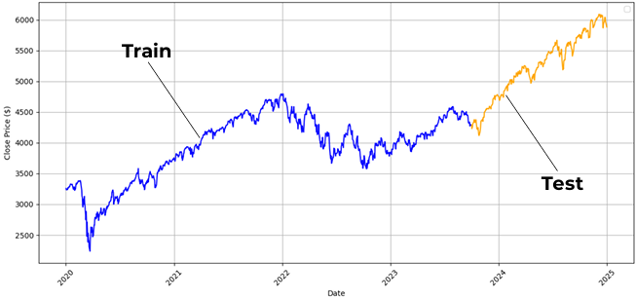
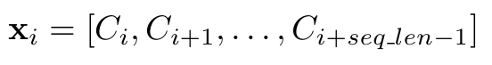
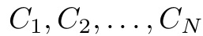
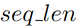
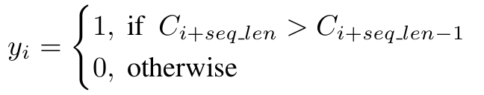
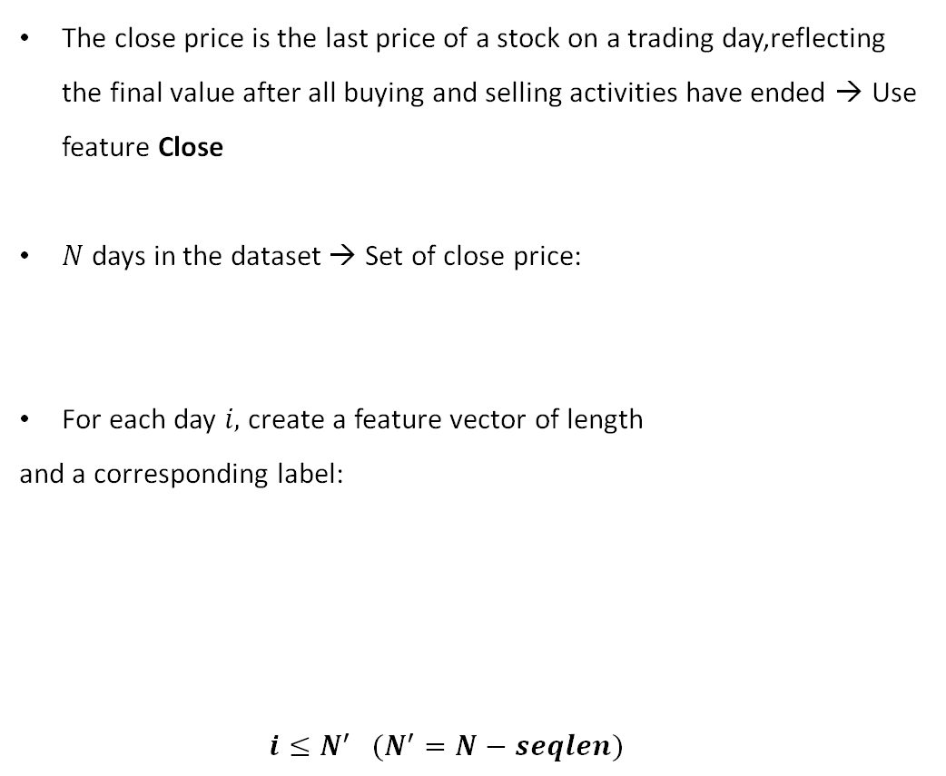
1. Data Preprocessing
Split dataset into 2 sets: Train and Test with
parameter split_ratio
The close price is the last price of a stock on a trading day,reflecting the final value after all buying and selling activities have ended → Use feature Close
$N$ days in the dataset → Set of close price:
For each day $i,$ create a feature vector of length
and a corresponding label:
$i≤N^{′} (N^{′}=N−seqlen)$

Slide 19
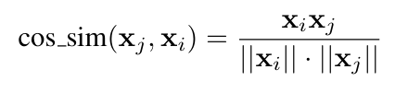
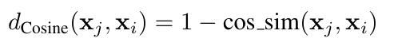
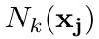
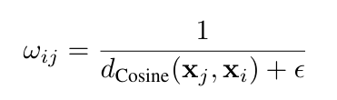
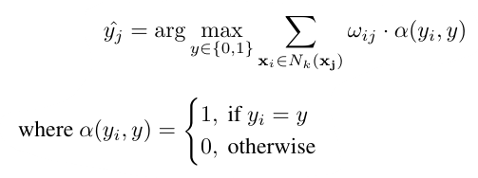
2. Weighted KNN
Process
Cosine distance between a query point (maybe a point in test set for evaluating or a new query point for forcasting)
→ Find set of k nearest neighbors
2. Weight of each data point in Train set:
3. Weighted Majority Voting, find the class that has the greater sum of weights:

Slide 20
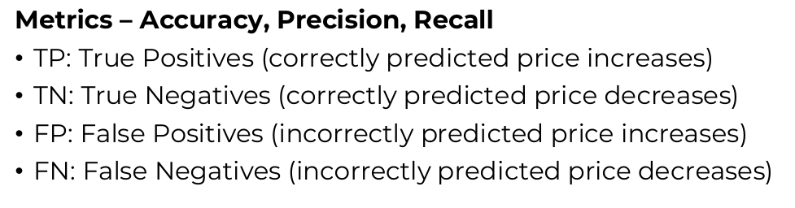
3. Results
Measures the ratio of correct predictions to total predictions
Measures the confidence of an increasing prediction , helping investors reduce the risk of buying a stock that will fall in price.
Measures the ability to detect all days when prices actually increase, helping investors not miss out on profitable opportunities.
Use Grid Search to optimize 2 parameters $seq_len$and $k$.

Slide 21
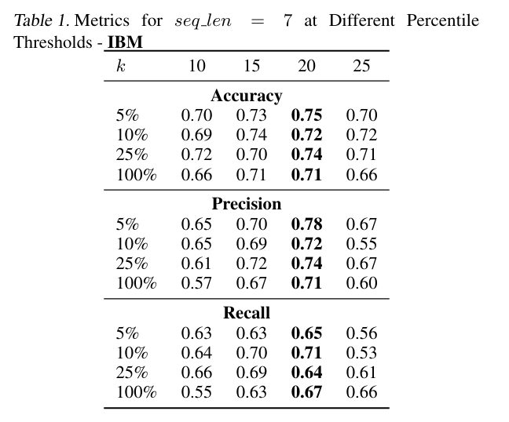
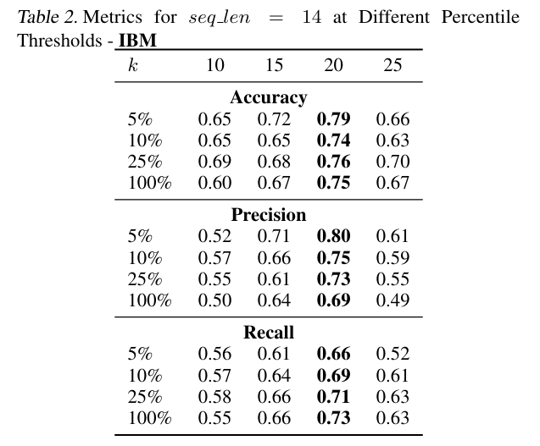
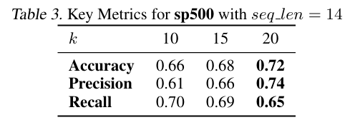
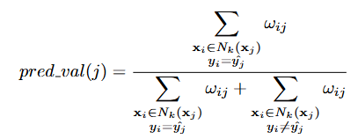
3. Results
Use Grid Search to optimize 2 parameters $seq_len$and $k$.
Percentile p%: Top p% samples in Test set that have greatest value of pred_val

Slide 22
Random Forest Classifier

Slide 23
Random Forest Classifier
Grid search is used in this algorithm
Three hyperparameters are tuned: n_estimators, max_depth and max_features.
n_estimators:
The n_estimator parameter controls the number of trees inside the classifier. The list of n_estimators we take here is [100, 200, 300].
max_depth:
It governs the maximum height up to which the trees inside the forest can grow. The list of max_depth we take here is [3, 5, 7, 9, None].
max_features:
helps to find the number of features to take into account at each node in order to make the best split. The list of max_features we take here is [3, 4, 5].
In our project, we use grid search in combination with rolling cross validation to tune these hyperparameter

Slide 24
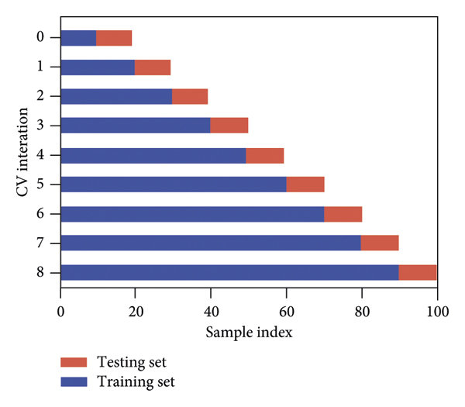
Random Forest Classifier
Rolling cross-validation
Initial Split: dividing the dataset into k folds. Each fold consists of a contiguous sequence of observations.
Training and Testing: In each iteration, one fold is designated as the test set, and the preceding folds are used for training.
Iterative Process: The process is repeated k times, each time moving the test set to the next contiguous sequence of observations.
Popular choices of K: 10 or 5.
We choose k = 5 and do not shuffle the data

Slide 25
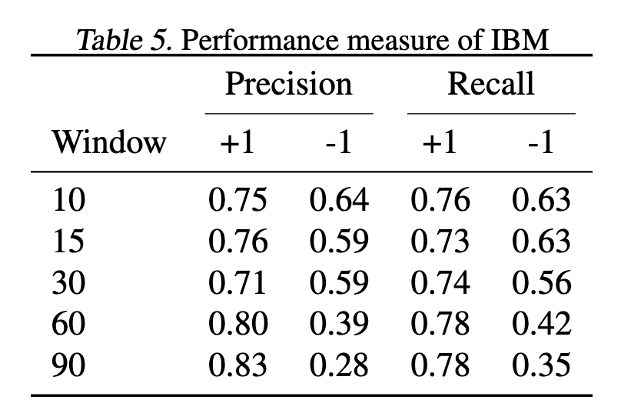
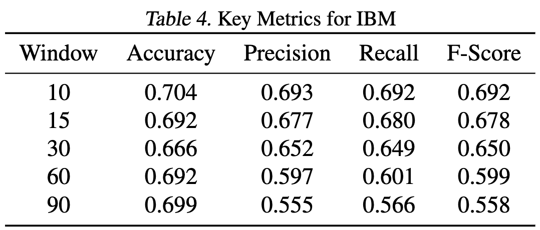
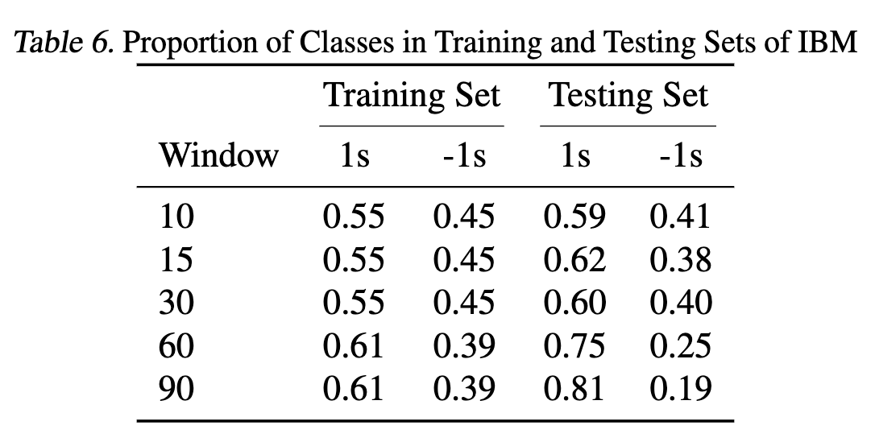
Random Forest Classifier
IBM

Slide 26
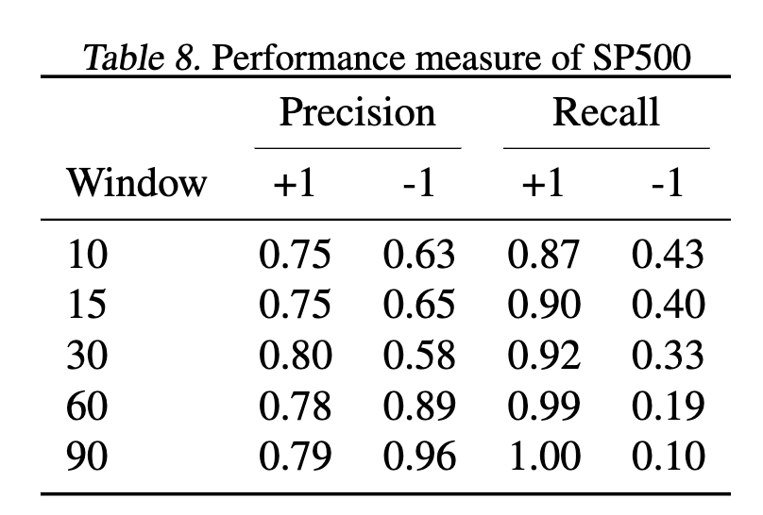
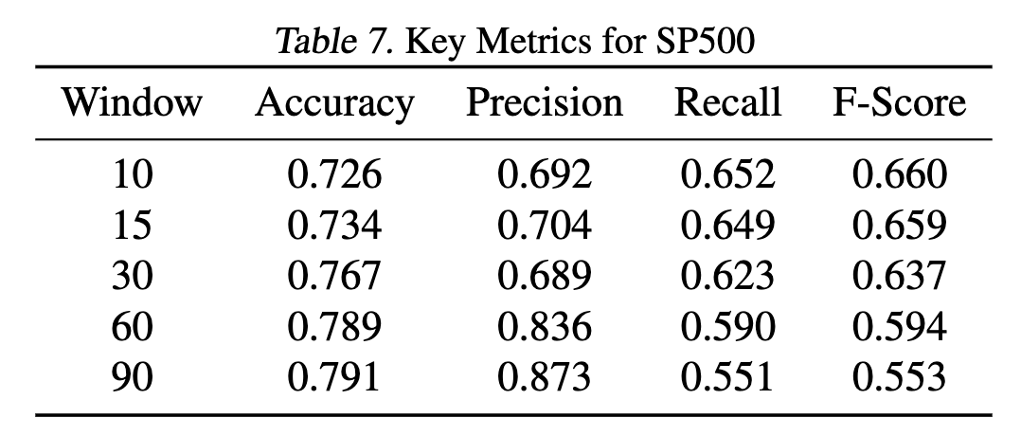
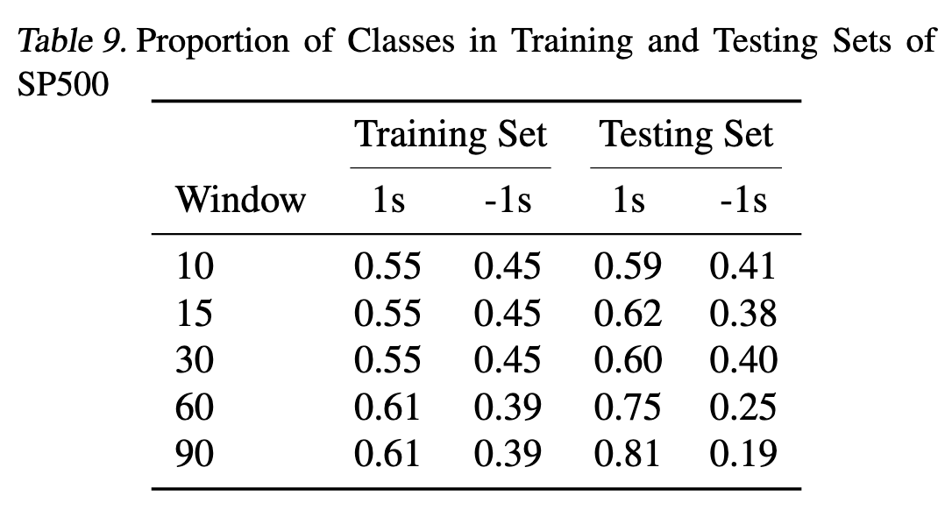
Random Forest Classifier
S&P500

Slide 27
LSTM & GRU

Slide 28
Long Short-Term Memory Gated Recurrent Units
Data Preprocessing
LSTM, GRU
Result Analysis

Slide 29
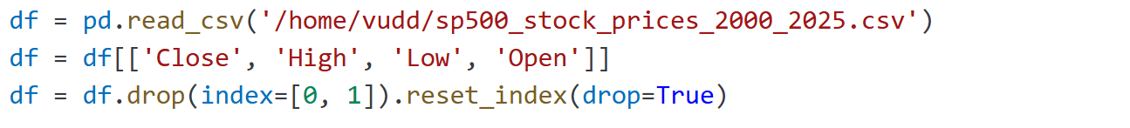
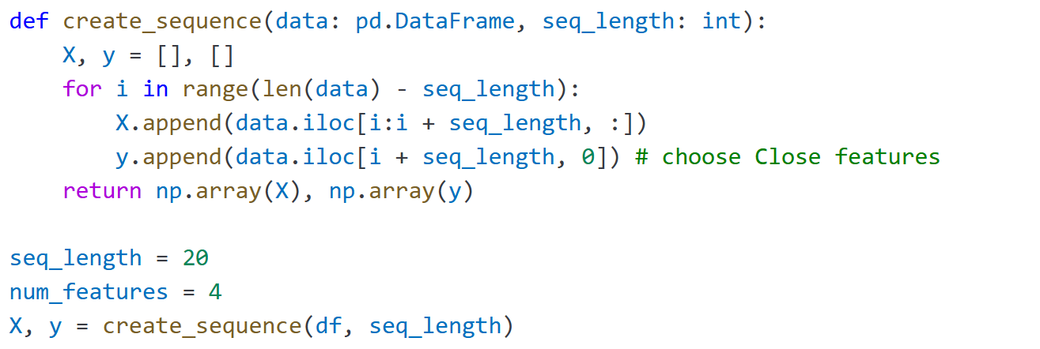
LSTM, GRU
Data Preprocessing
1.1. Load and select columns
1.2. Create sliding-windows sequences
Raw series are one long, unlabeled sequence. Sliding windows turn it into many (input → target) pairs (e.g. past 20 days → next day)

Slide 30
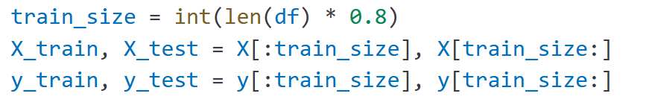
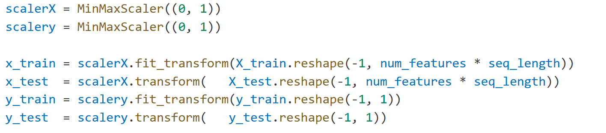
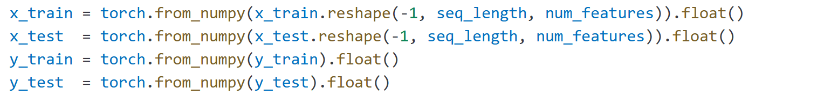
LSTM, GRU
Data Preprocessing
1.3. Train-Test split
1.4. Scaling ​
1.5. Convert to
Pytorch tensors

Slide 31
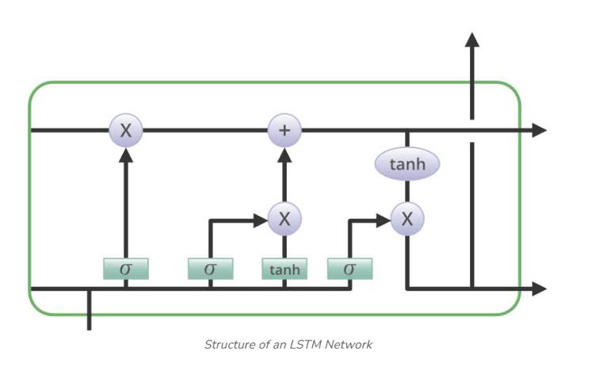
LSTM, GRU
2. Model and Model training
2.1. Long short-term Memory (LTSM)
Long Short-Term Memory (LSTM) networks are a type of RNN designed to overcome the vanishing gradient problem, specifically effective in learning long-range dependencies in sequential data.
The key innovation is in the use of cell state, along with multiple gates (forget, input and output gates), which control the flow of information.

Slide 32
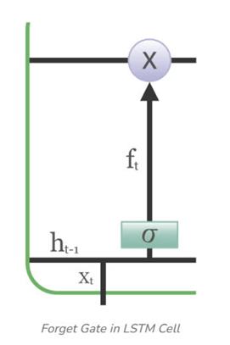
LSTM, GRU
2. Model and Model training
2.1. Long short-term Memory (LTSM)
Cell State (C_{t}): The cell state carries information throughout the sequence. It is updated at each time step using the forget and input gates, allowing the network to retain long-term memory.
Forget Gate (f_{t}): The forget gate determines which portion of the previous cell state should be carried forward to the next time step. It is computed as:

Slide 33
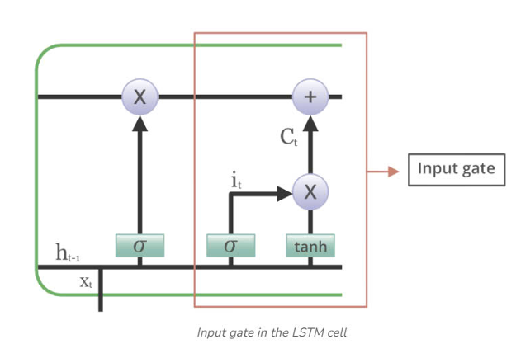
LSTM, GRU
2. Model and Model training
2.1. Long short-term Memory (LTSM)
Input Gate (I_{t}): The input gate controls how much new information should be added to the cell state
Candidate Cell State (C^~_t): The candidate cell state is a new proposed value that could be added to the cell state. It is computed as:

Slide 34
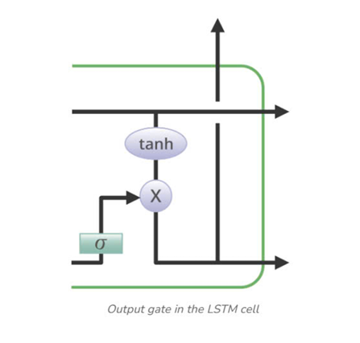
LSTM, GRU
2. Model and Model training
2.1. Long short-term Memory (LTSM)
Output Gate (O_{t}): The output gate determines what the next hidden state will be based on the current cell state.

Slide 35
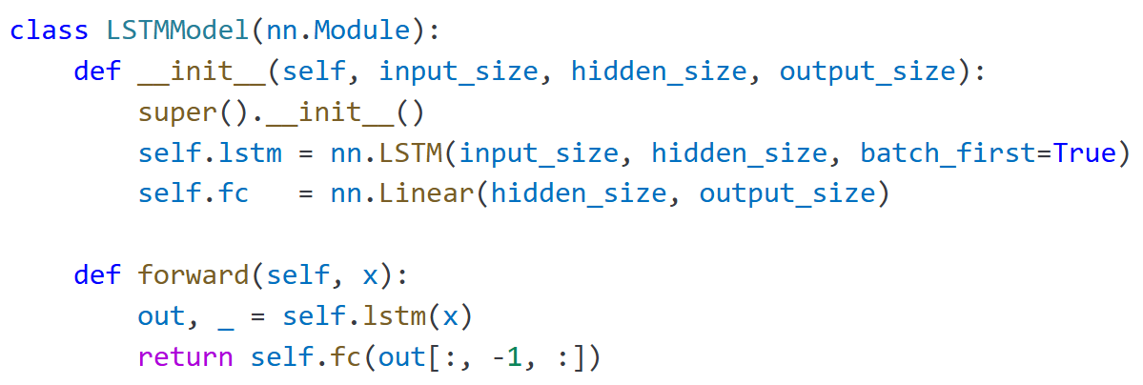
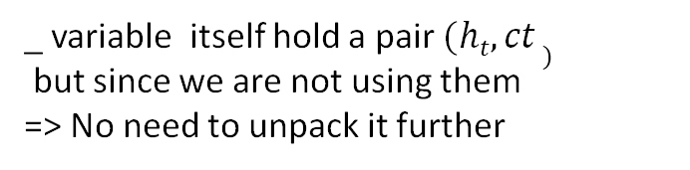
LSTM, GRU
2. Model and Model training
2.2. Model definition and training
_ variable itself hold a pair $(ht, ct )$
but since we are not using them
=> No need to unpack it further

Slide 36
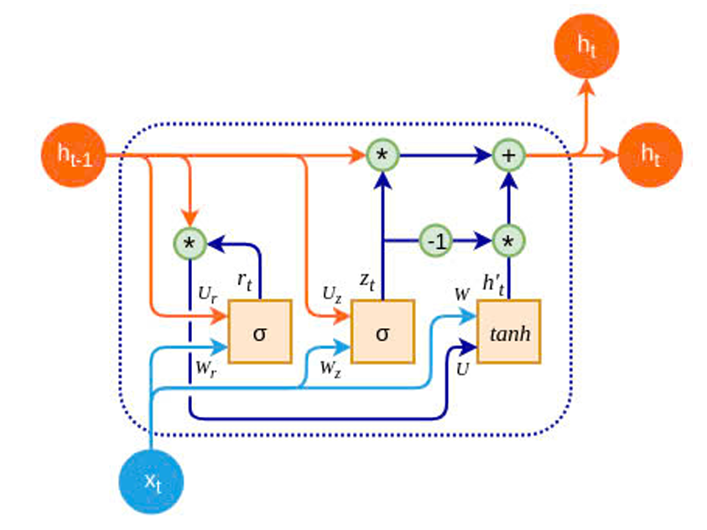
LSTM, GRU
2. Model and Model training
2.3. Gated Recurrent Unit (GRU)
Gated Recurrent Unit (GRU) streamlines the LSTM design by merging the input and forget gates into a single update gate, while retaining a reset gate to manage short-term memory. This simplification reduces the number of trainable parameters, which can accelerate convergence on smaller datasets or under constrained computational budgets.

Slide 37
LSTM, GRU
2. Model and Model training
2.3. Gated Recurrent Unit (GRU)
The reset gate determines how much of the previous hidden state h_{t-1} should be forgotten.
The update gate controls how much of the new information x_{t} should be used to update the hidden state
This is the potential new hidden state calculated based on the current input and the previous hidden state.
The final hidden state is a weighted average of the previous hidden state h_{t-1} and the candidate hidden state h′_{t} based on the update gate z_{t}

Slide 38
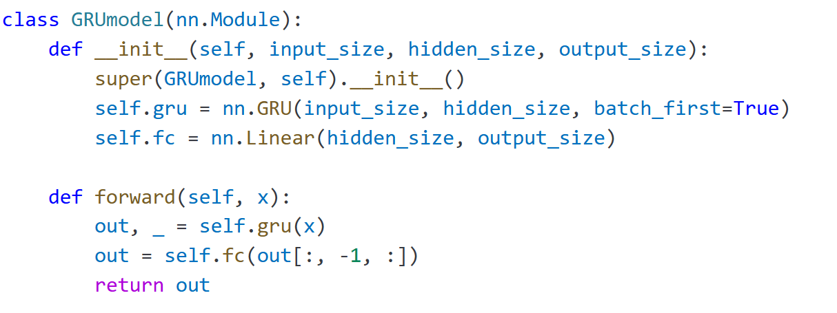
LSTM, GRU
2. Model and Model training
2.4. Model definition and training

Slide 39
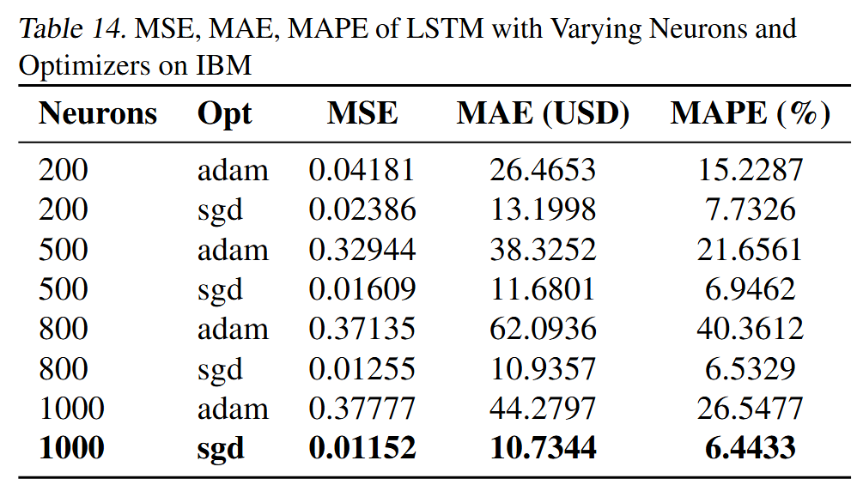
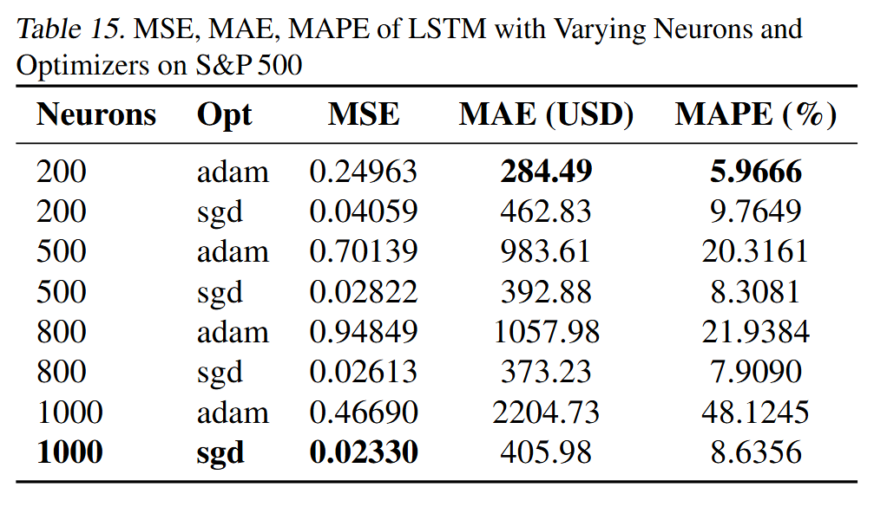
Hyperparameter Tuning for LSTM
3. Result Analysis
IBM
Sp500

Slide 40
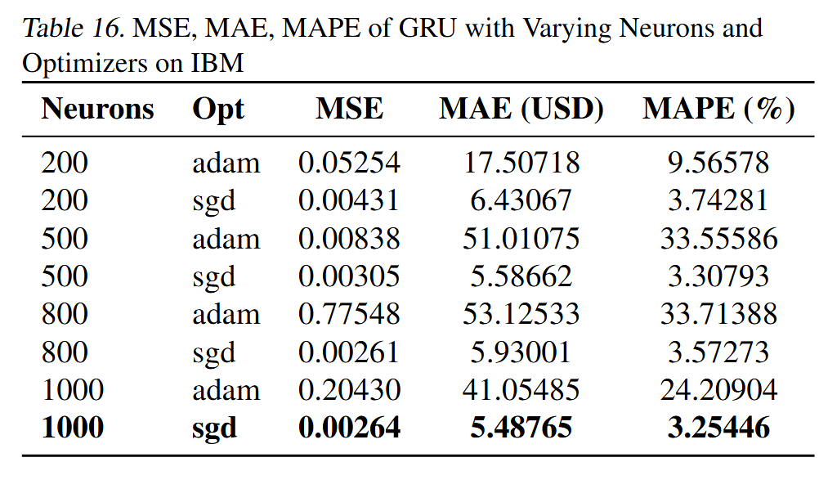
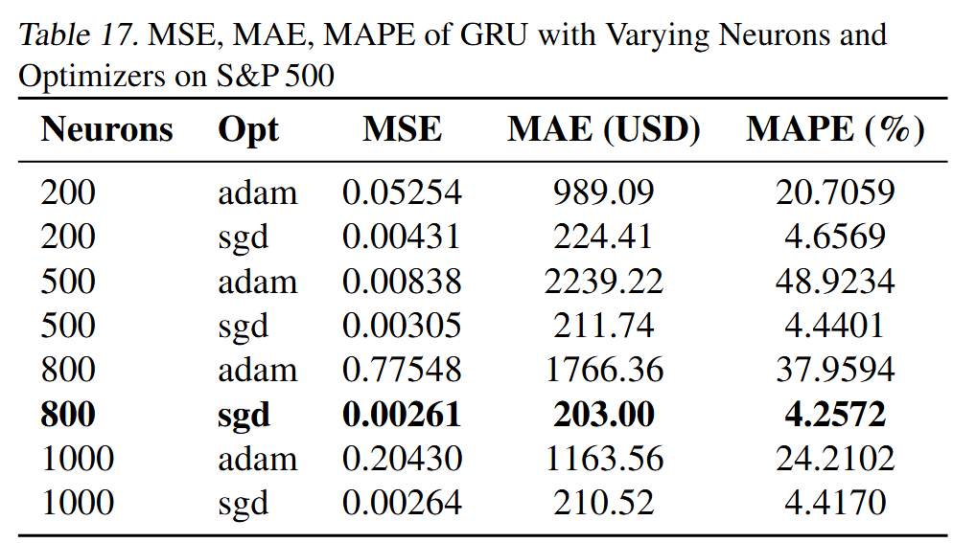
Hyperparameter Tuning for GRU
3. Result Analysis
IBM
Sp500

Slide 41
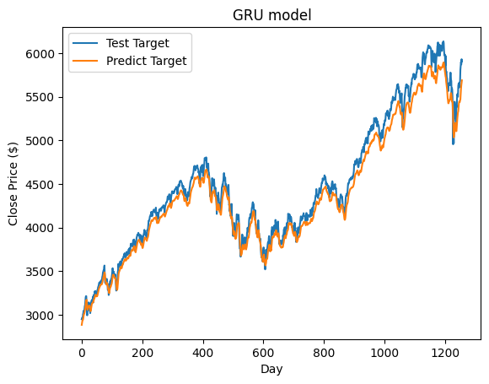
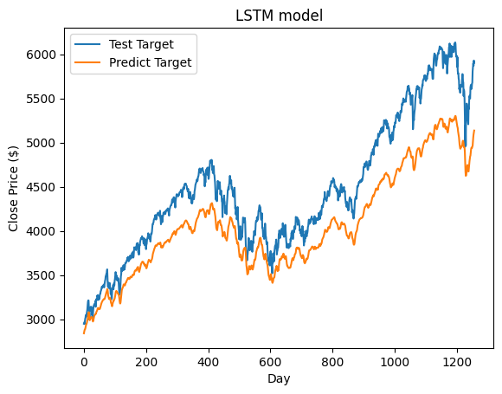
LSTM, GRU
3. Result Analysis
We tested on various neurons and optimizers for both SP500 Index and selected the best configuration for both models.

Slide 42
LSTM, GRU visualization

Slide 43
Random Forest Regression

Slide 44
Random Forest Regression
Basic Idea:
An ensemble method that consists of many decision trees that give the average predictions of each tree
Tree
Tree
Tree
Forest
+
+
=
Model Prediction
= AVG (Tree Predictions)
Prediction 1
Prediction 2
Prediction 3

Slide 45
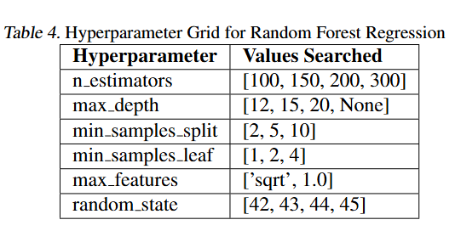
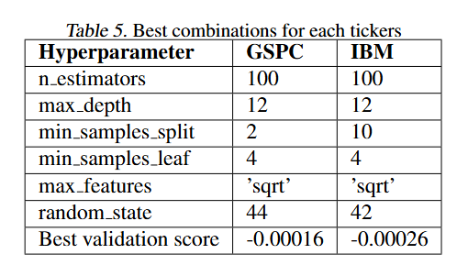
Random Forest Regression
Tuning model:
We use GridSearchCV with rolling cross validation to find the best combination of hyperparameters

Slide 46

Random Forest Regression
Result:

Slide 47
XGBoost

Slide 48
XGBoost
Basic Idea:
An ensemble method that consists of many weak learners that keep improving the result
Bad model
Bad model
Bad model
Good model
+
+
=
Prediction 1
Prediction 2
Prediction 3
Model Prediction

Slide 49


XGBoost
Tuning model:
We use GridSearchCV with rolling cross validation to find the best combination of hyperparameters

Slide 50

XGBoost
Result:

Slide 51
Conclusion

Slide 52
Classification
From Grid Search, values of k and seq_len whose performance is the best is: (k, seq_len) = (20, 14)
 | Accuracy | Precision | Recall
5% | 0.79 | 0.80 | 0.66
10% | 0.74 | 0.75 | 0.69
25% | 0.76 | 0.73 | 0.71
100% | 0.75 | 0.69 | 0.73
Use Grid Search to optimize 2 parameters $seq_len$and $k$.

Slide 53
2. Regression
S&P500
IBM
Model | MSE | MAE | MAPE
RF | 11201.9307 | 93.8262 | 2.09%
XGB | 10969.6307 | 81.9915 | 1.90%
GRU | 12910.0420 | 97.0237 | 2.07%
LSTM | 193953.0469 | 399.5040 | 8.52%
Model | MSE | MAE | MAPE
RF | 30.8750 | 3.9518 | 2.47%
XGB | 26.1513 | 3.7511 | 2.38%
GRU | 760.5258 | 18.0670 | 9.93%
LSTM | 103.7740 | 5.7999 | 3.12%

Slide 54
Website

Slide 55
MLOPS – Data Pipeline
17:30 PM NYT fetch data
Save data to database
GRU
LSTM
RFC
KNN
Close price for the next day
Close price for the next day
Next 30 days trend (up or down)
Next 30 days trend (up or down)
Save to database and display the diagram

Slide 56

Website
Choose stock

Slide 57
Website
History display
Model we want to use
Diagram

Slide 58

Website
Predict next close price
Predict trend of 30 days after

Slide 59

Website
Ending with historical data table

Slide 60
MLOPS – RUNNING THE PROJECT
Github
Docker
Step 1: Clone the repository using the github link above
$ git clone https://github.com/Duckduck-05/MachineLearningProject.git
Step 2: Install dependencies
$ python –m venv venv
$ pip install –r requirements.txt
Step 3: Run api server
$ python -m uvicorn app.api_server:app --host localhost --port 8000 --reload
Step 4: run the scheduler task
$ python –m app.main_worker
Step 5: Run our website
$ streamlit run ui/app.py --server.port 8501 --server.address localhost
Step 6: Head to localhost:8501 to access the website
Step 1: Pull the repository using the docker link above
$ docker pull hungtrab/stock_prediction:latest
Step 2: Copy the docker-compose.yml file in Github to local folder
Step 3: Run the container and services
$ docker-compose up
Step 4: Head to localhost:8501 to access the website
Our Website
We also host the project using AWS EC2 and Streamlit app. The website is available at:
https://stockbook.streamlit.app/
http://52.64.105.162:8501/ (mirror link)

Slide 61
References

Slide 62
REFERENCES
[1] S. Basak, S. Kar, S. Saha, L. Khaidem, and S. R. Dey, “Predicting the direction of stock market prices using tree-based classifiers,” The North American Journal of Economics and Finance, vol. 47, pp. 552–567, 2019. https://doi.org/10.1016/j.najef.2018.06.013
[2] S. Hochreiter and J. Schmidhuber, “Long short-term memory,” Neural Computation, vol. 9, no. 8, pp. 1735–1780, 1997. https://doi.org/10.1162/neco.1997.9.8.1735
[3] F. Black, “Noise,” The Journal of Finance, vol. 41, no. 3, pp. 528–543, 1986. https://doi.org/10.1111/j.1540-6261.1986.tb04513.x
[4] K. Pearson, “On lines and planes of closest fit to systems of points in space,” Philosophical Magazine, vol. 2, no. 11, pp. 559–572, 1901. https://doi.org/10.1080/14786440109462720
[5] R. M. Schmidt, “Recurrent Neural Networks (RNNs): A gentle Introduction and Overview,” arXiv preprint arXiv:1912.05911, 2019. https://arxiv.org/abs/1912.05911
[6] P. Cunningham and S. J. Delany, “k-Nearest Neighbour Classifiers: 2nd Edition (with Python examples),” arXiv preprint arXiv:2004.04523, 2020. https://arxiv.org/abs/2004.04523
[7] P. Probst, M. Wright, and A.-L. Boulesteix, “Hyperparameters and tuning strategies for random forest,” WIREs Data Mining and Knowledge Discovery, vol. 9, no. 3, e1301, 2019. https://doi.org/10.1002/widm.1301
[8] Y. Wang, Y. Zhang, and Y. Wang, “Stock market prediction with multi-information fusion and recurrent neural network,” in 2019 IEEE 10th International Conference on Software Engineering and Service Science (ICSESS), Beijing, China, 2019, pp. 685–688. https://doi.org/10.1109/ICSESS47205.2019.8900675

Slide 63
Question And Answer Q&A

Slide 64
THANK YOU !

Slide 65

INTRODUCTION
Background
Predicting stock prices is a complex and challenging task.
The ability to accurately forecast stock prices has significant implications for investors, traders, and financial institutions
It can help them make informed decisions and maximize returns.

Slide 66
INTRODUCTION
Background
Lots of models have been created and get success:
Gaussian Discriminant Analysis
Quadratic discriminant analysis
LR and SVM of Zhang Dai (2013)
RF or Xtreme Gradient Boosting

Slide 67
INTRODUCTION
2. Problem description
Predicting the trends in stock market prices, i.e. whether a stock price would rise or fall has been an area of interest for many researchers and also for investors due to its importance in influencing the traders’ future decision to either buy or sell an instrument which could yield significant profit.
Furthermore, the problem of stock direction prediction has been studied as a regression as well as a classification problem. However, treating this problem as a classification problem gives more accurate results than treating it as a regression problem due to that the outcome of the response variable in the classification algorithms is arranged to be binary, i.e. two-class, either upward trends (bull trends) or downward trends (bear trends).

Slide 68
INTRODUCTION
3. Aim
Random Forest Classification(RFC)
Supervised classification algorithms have gained attention as efficient predictors of stock market trends. We propose efficient methods for predicting both trend and price movements in the stock market.
K-Nearest Neighbor(KNN)
STOCK PRICE PREDICTION
Feel free to see our Github and Docker
Long Short-Term Memory(LSTMs)
Long Short-Term Memory(LSTMs)

Slide 69


Solution
Visualize the results
Implement a web application shows real-time predicted values and graphically tracks changes in predicted and actual prices.

Slide 70
KNN

Slide 71
KNN
Data Description
Normal KNN
Weight KNN
Result Analysis

Slide 72
KNN
Data Preprocessing
1.1. Data Description
Historical data of two stocks, S&P500(^GSPC) and IBM Stock(IBM) from 2000-01-01 to 2023-06-01.
The data sample is obtained from Yahoo Finance.
It consists of the daily closing prices with a total number of samples including 5890 trading days for each stock.

Slide 73


KNN
3.3. Metrics
Type | Formula
Weight function | $$wi= \frac{1}{d\left(x, xi\right)+ ε}$$
Weight voting rule | $$y^{^ }=\left\{\begin{aligned}1 , if \frac{\sum_{i ∈Nk(x)}{wiyi }}{\sum_{i ∈Nk(x)}{wi} }>0.5 \\ 0, otherwise \end{aligned}\right.$$
Where:
+ $wi$ is the weight of neighbor i
+ $ε$ is the small constant avoid division by zero

Slide 74




KNN
3.4. Advantages
More robust to noisy or misleading neighbors that are far from the query point.
Reflects the intuition that nearby points are more similar.
Particularly beneficial in high-dimensional or sparse datasets.
4. Result analytics
4.1. Performance
SP500
IBM

Slide 75


KNN
4.2. Results
SP500
IBM

Slide 76
Random Forest Classifier

Slide 77
Random Forest Classifier
Data Preprocessing
Random Forest Classifier
Result Analysis

Slide 78

Random Forest Classifier
Data Preprocessing
1.1. Exponential Smoothing
Exponential smoothing is a time series forecasting technique useful for forecasting data that exhibits a trend.
The main idea behind exponential smoothing is to assign exponentially decreasing weights to past observations, with more recent observations receiving higher weights.
The simplest exponential smoothing method is the single exponential smoothing (SES); is used in this model.
$$S_{t+1}= αY_{t}+\left(1 − α\right)S_{t}; S_{0}=Y_{0}$$
where,
t is time period,
$Y_{t}$is the actual observation,
$S_{t}$ is the smoothed statistics.
For different trading window, we choose value $α= \frac{2}{trading_window+1}$

Slide 79


Random Forest Classifier
Data Preprocessing
1.1. Exponential Smoothing

Slide 80
Random Forest Classifier
Data Preprocessing
1.2. Technical Indicators
Technical indicators are useful tools that can be used to advance technical analysis.
These indicators help investors to make decisions regarding the buying and selling of the stocks.
The feature selection in this paper is based on the most used technical indicators that produced significant results with RF technique in prior studies.
Relative Strength Index (RSI)
Moving Average Convergence Divergence (MACD)
Price Rate of Change (ROC)
Stochastic Oscillator (%K)
Commodity Channel Index (CCI)
On-Balance Volume (OBV)
Disparity Index (DIX)
Average True Mean (ATR)
Chainkin Money Flow (CMF)

Slide 81


Random Forest Classifier
Data Preprocessing
1.3. Data Labelling
The target predicted in the next n days is calculated from using the smoothed prices of both stocks:
$$Target_{i}=Sign(Smooth_{i+n}−Smooth_{i})$$
where,
a negative value of the target indicates that the price of the stock has fallen where a positive value of the target indicates that the price of the stock has raised after n days.

Slide 82

Random Forest Classifier
Data Preprocessing
1.5. Correlation-based features selection
Correlation-based feature selection is a technique that identifies and selects the most relevant features by measuring their correlation with the target variable.
If two predictor variables are correlated, the variable with a lower correlation coefficient value with the target variable can be dropped.
We need to set an absolute value, say 0.80, as the threshold for selecting the variables.

Slide 83

Random Forest Classifier
Data Preprocessing
1.5. Correlation-based features selection
Here, we decide to drop CCI and ATR.
Correlation matrix of S&P500 indicators
Correlation matrix of IBM indicators

Slide 84
Random Forest Classifier
2. About RFC model
2.1. Random Forest
Random forests (RF) is a method by Leo Breiman (2001) for both classification and regression.
Main idea: prediction is based on combination of many decision trees, by taking the average of all individual predictions.
Each tree in RF is simple but random.
Each tree is grown differently, depending on the choices of the attributes and training data.

Slide 85








Random Forest Classifier
2. About RFC model
2.2. Model Evaluation Criteria
Macro-averaging for precision and recall
$$Precision\left(+1\right)= \frac{TP}{TP+FP}$$
$$Accuracy= \frac{TP+TN}{TP+TN+FP+FN}$$
$$Precision\left(−1\right)= \frac{TN}{TN+FN}$$
$$Precision= \frac{Precision\left(+1\right)+Precision(−1)}{2}$$
$$Recall\left(+1\right)= \frac{TP}{TP+FN}$$
$$Recall= \frac{Recall\left(+1\right)+Recall(−1)}{2}$$
$$Recall\left(−1\right)= \frac{TN}{TN+FP}$$
$$F1 Score= \frac{2∗Precision∗Recall}{Precision+Recall}$$

Slide 86




Random Forest Classifier
2. About RFC model
2.2. Model Evaluation Criteria
Macro-averaging for precision and recall
$$Accuracy= \frac{TP+TN}{TP+TN+FP+FN}$$
$$Precision= \frac{Precision\left(+1\right)+Precision(−1)}{2}$$
$$Recall= \frac{Recall\left(+1\right)+Recall(−1)}{2}$$
TP is number of true +1 values
TN is number of true -1 values
FP is number of false +1 values
FN is number of false -1 values
$$F1 Score= \frac{2∗Precision∗Recall}{Precision+Recall}$$

Slide 87
Random Forest Classifier
3. Result Analysis
Grid search is used in this algorithm
Three hyperparameters are tuned for all four types of assessments: n_estimators, max_depth and max_features.
n_estimators:
The n_estimator parameter controls the number of trees inside the classifier. The list of n_estimators we take here is [100, 200, 300].
max_depth:
It governs the maximum height up to which the trees inside the forest can grow. The list of max_depth we take here is [3, 5, 7, 9, None].
max_features:
helps to find the number of features to take into account at each node in order to make the best split. The list of max_features we take here is [3, 4, 5].
In our project, we use grid search in combination with rolling cross validation to tune these hyperparameter

Slide 88

Random Forest Classifier
Result Analysis
3.1. Rolling cross-validation
Training the model on a "window" (a fixed amount) of past data.
Testing the model on the data points immediately following that training window.
"Rolling" this train/test window forward in time by a set increment (e.g., one step).
Popular choices of K: 10 or 5.
We choose k = 5 and do not shuffle the data

Slide 89
Random Forest Classifier
Result Analysis
3.2. Results
IBM

Slide 90
Random Forest Classifier
Result Analysis
3.2. Results
S&P500

Slide 91
Random Forest Classifier
Result Analysis
3.3. Conclusion
For predicting IBM and S&P 500 movements, a Random Forest Classifier performs best with shorter look-back windows (10-30 trading days). In this range, it achieves accuracies of 0.70-0.77 and F1 scores in the mid-0.60s, with balanced precision and recall for both "up" and "down" predictions.
Conversely, as the window exceeds 30 days, the test data becomes heavily skewed towards "up" days (over 80%). This causes the model to overwhelmingly predict "up," leading to very high precision for "up" days (0.96-0.99) but extremely poor precision and recall for "down" days, dragging the overall F1 score down to around 0.55.

Slide 92
Long Short-Term Memory Gated Recurrent Units
Data Preprocessing
LSTM, GRU
Result Analysis

Slide 93
LSTM, GRU
Data Preprocessing
1.1. Load and select columns
1.2. Create sliding-windows sequences
Raw series are one long, unlabeled sequence. Sliding windows turn it into many (input → target) pairs (e.g. past 20 days → next day)

Slide 94
LSTM, GRU
Data Preprocessing
1.3. Train-Test split
1.4. Scaling ​
1.5. Conver to
Pytorch tensors

Slide 95
LSTM, GRU
2. Model and Model training
2.1. Long short-term Memory (LTSM)
Long Short-Term Memory (LSTM) networks are a type of RNN designed to overcome the vanishing gradient problem, specifically effective in learning long-range dependencies in sequential data.
The key innovation is in the use of cell state, along with multiple gates (forget, input and output gates), which control the flow of information.

Slide 96
LSTM, GRU
2. Model and Model training
2.1. Long short-term Memory (LTSM)
Cell State (C_{t}): The cell state carries information throughout the sequence. It is updated at each time step using the forget and input gates, allowing the network to retain long-term memory.
Forget Gate (f_{t}): The forget gate determines which portion of the previous cell state should be carried forward to the next time step. It is computed as:

Slide 97
LSTM, GRU
2. Model and Model training
2.1. Long short-term Memory (LTSM)
Input Gate (I_{t}): The input gate controls how much new information should be added to the cell state
Candidate Cell State (C^~_t): The candidate cell state is a new proposed value that could be added to the cell state. It is computed as:

Slide 98
LSTM, GRU
2. Model and Model training
2.1. Long short-term Memory (LTSM)
Output Gate (O_{t}): The output gate determines what the next hidden state will be based on the current cell state.

Slide 99
LSTM, GRU
2. Model and Model training
2.2. Model definition and training
_ variable itself hold a pair $(ht, ct )$
but since we are not using them
=> No need to unpack it further

Slide 100
LSTM, GRU
2. Model and Model training
2.3. Gated Recurrent Unit (GRU)
Gated Recurrent Unit (GRU) streamlines the LSTM design by merging the input and forget gates into a single update gate, while retaining a reset gate to manage short-term memory. This simplification reduces the number of trainable parameters, which can accelerate convergence on smaller datasets or under constrained computational budgets.

Slide 101
LSTM, GRU
2. Model and Model training
2.3. Gated Recurrent Unit (GRU)
The reset gate determines how much of the previous hidden state h_{t-1} should be forgotten.
The update gate controls how much of the new information x_{t} should be used to update the hidden state
This is the potential new hidden state calculated based on the current input and the previous hidden state.
The final hidden state is a weighted average of the previous hidden state h_{t-1} and the candidate hidden state h′_{t} based on the update gate z_{t}

Slide 102
LSTM, GRU
2. Model and Model training
2.4. Model definition and training

Slide 103
LSTM, GRU
3. Result Analysis
We tested on various neurons and optimizers for both SP500 Index and selected the best configuration of 1000 neurons with the SGD optimizer for both models

